Slide 1
Data Structure and Algorithm (PMSCS 623P)
Lecture 8
Divide and Conquer (Quicksort)

Slide 2
Quicksort
Follows the divide-and-conquer paradigm.
Divide: Partition (separate) the array A[p..r] into two (possibly empty) subarrays A[p..q–1] and A[q+1..r].
Each element in A[p..q–1] ≤ A[q].
A[q] < each element in A[q+1..r].
Index q is computed as part of the partitioning procedure.
Conquer: Sort the two subarrays by recursive calls to quicksort.
Combine: The subarrays are sorted in place – no work is needed to combine them.

Slide 3
Pseudocode
PARTITION(A, p, r)
x = A[r]
2. i = p-1
3. for j = p to r – 1
4. if A[j] ≤ x
5. i = i + 1
6. exchange A[i] with A[j]
7. exchange A[i + 1] with A[r]
8. return i + 1
QUICKSORT(A, p, r)
1. if p < r then
2. q = PARTITION(A, p, r);
3. QUICKSORT (A, p, q – 1);
4. QUICKSORT (A, q + 1, r)
A[p..r]
5
A[p..q – 1]
A[q+1..r]
Partition
5
≤ 5
> 5

Slide 4
Example
p r
initially: 2 5 8 3 9 4 1 7 10 6 note: pivot (x) = 6
i j
next iteration: 2 5 8 3 9 4 1 7 10 6
i j
next iteration: 2 5 8 3 9 4 1 7 10 6
i j
next iteration: 2 5 8 3 9 4 1 7 10 6
i j
next iteration: 2 5 3 8 9 4 1 7 10 6
i j
PARTITION(A, p, r)
x = A[r]
2. i = p-1
3. for j = p to r – 1
4. if A[j] ≤ x
5. i = i + 1
6. exchange A[i] with A[j]
7. exchange A[i + 1] with A[r]
8. return i + 1

Slide 5
Example (Continued)
next iteration: 2 5 3 8 9 4 1 7 10 6
i j
next iteration: 2 5 3 8 9 4 1 7 10 6
i j
next iteration: 2 5 3 4 9 8 1 7 10 6
i j
next iteration: 2 5 3 4 1 8 9 7 10 6
i j
next iteration: 2 5 3 4 1 8 9 7 10 6
i j
next iteration: 2 5 3 4 1 8 9 7 10 6
i j
after final swap: 2 5 3 4 1 6 9 7 10 8
i j
PARTITION(A, p, r)
x = A[r]
2. i = p-1
3. for j = p to r – 1
4. if A[j] ≤ x
5. i = i + 1
6. exchange A[i] with A[j]
7. exchange A[i + 1] with A[r]
8. return i + 1

Slide 6
Partitioning
Select the last element A[r] in the subarray A[p..r] as the pivot – the element around which to partition.
As the procedure executes, the array is partitioned into four (possibly empty) regions.
A[p..i] — All entries in this region are ≤ pivot.
A[i+1..j – 1] — All entries in this region are > pivot.
A[r] = pivot.
A[j..r – 1] — Not known how they compare to pivot.

Slide 7

Hoare’s Quicksort Example:
L < P </= R
When researching Quicksort you’ll find a few different popular methods used but they’re all basically the same idea. Here we’re going to look at one of the most popular, Hoare’s Quicksort, which puts the Pivot on one end and works down the list or array.
•
(put the = sign on same side as your pivot)
Left
#’s < P (7)
Right
#’s >/= P (7)
13
3
8
4
6
9
7
P (Pivot) = 7
If the Number (#) is Greater Than/ Equal to (>/=) the Pivot, it Stays Put
Else, if its Less Than (<) the Pivot, Swap it with 1st Element >/= than P

Slide 8




Hoare’s Quicksort Example:
L < P </= R
All 4 of these bullet points that you see here are the basic rules, or checks, that we’ll be using to sort. This is the basic logic defined by the underlying code.
•
(put the = sign on same side as your pivot)
Left
#’s < P (7)
Right
#’s >/= P (7)
13
3
8
4
6
9
7
P (Pivot) = 7
If the Number (#) is Greater Than/ Equal to (>/=) the Pivot, it Stays Put
Else, if its Less Than (<) the Pivot, Swap it with 1st Element >/= than P

Slide 9
Hoare’s Quicksort Example:
•
L < P </= R
So first we pick our Pivot (P), in this example at random.
We’ve decided to go with the last element in the sequence, 7, and we’ll do this with each recursion going down as needed until the sorting is complete.
(put the = sign on same side as your pivot)
Left
#’s < P (7)
Right
#’s >/= P (7)
13
3
8
4
6
9
7
P (Pivot) = 7
If the Number (#) is Greater Than/ Equal to (>/=) the Pivot, it Stays Put
Else, if its Less Than (<) the Pivot, Swap it with 1st Element >/= than P

Slide 10
Hoare’s Quicksort Example:
•
L < P </= R
This is our Partition divider, every element on the left will be less than our pivot and everything on the right will be greater ( or equal to ) our pivot.
(put the = sign on same side as your pivot)
Left
#’s < P (7)
Right
#’s >/= P (7)
13
3
8
4
6
9
7
P (Pivot) = 7
If the Number (#) is Greater Than/ Equal to (>/=) the Pivot, it Stays Put
Else, if its Less Than (<) the Pivot, Swap it with 1st Element >/= than P

Slide 11
Hoare’s Quicksort Example:
L < P </= R
So we start from the left and compare each element to our pivot. Again we just check if its less than or greater and we move our partition divider and swap elements accordingly. Here 13 is greater than our pivot 7 so it is in the correct position, to the right of our divider.
•
(put the = sign on same side as your pivot)
Left
#’s < P (7)
Right
#’s >/= P (7)
13
3
8
4
6
9
7
P (Pivot) = 7
If the Number (#) is Greater Than/ Equal to (>/=) the Pivot, it Stays Put
Else, if its Less Than (<) the Pivot, Swap it with 1st Element >/= than P

Slide 12
Hoare’s Quicksort Example:
•
L < P </= R
3 is less than or pivot so we swap it with the first known element greater than our pivot, here the 13. And move our partition divider over one as well so that the lesser 3 is in the correct position.
(put the = sign on same side as your pivot)
Left
#’s < P (7)
Right
#’s >/= P (7)
13
3
8
4
6
9
7
P (Pivot) = 7
If the Number (#) is Greater Than/ Equal to (>/=) the Pivot, it Stays Put
Else, if its Less Than (<) the Pivot, Swap it with 1st Element >/= than P

Slide 13
Hoare’s Quicksort Example:
•
L < P </= R
3 is less than or pivot so we swap it with the first known element greater than our pivot, here the 13. And move our partition divider over one as well so that the lesser 3 is in the correct position.
(put the = sign on same side as your pivot)
Left
#’s < P (7)
Right
#’s >/= P (7)
3
13
8
4
6
9
7
P (Pivot) = 7
If the Number (#) is Greater Than/ Equal to (>/=) the Pivot, it Stays Put
Else, if its Less Than (<) the Pivot, Swap it with 1st Element >/= than P

Slide 14
Hoare’s Quicksort Example:
•
L < P </= R
3 is less than or pivot so we swap it with the first known element greater than our pivot, here the 13. And move our partition divider over one as well so that the lesser 3 is in the correct position.
(put the = sign on same side as your pivot)
Left
#’s < P (7)
Right
#’s >/= P (7)
3
13
8
4
6
9
7
P (Pivot) = 7
If the Number (#) is Greater Than/ Equal to (>/=) the Pivot, it Stays Put
Else, if its Less Than (<) the Pivot, Swap it with 1st Element >/= than P

Slide 15
Hoare’s Quicksort Example:
•
L < P </= R
3 is less than or pivot so we swap it with the first known element greater than our pivot, here the 13. And move our partition divider over one as well so that the lesser 3 is in the correct position.
(put the = sign on same side as your pivot)
Left #’s < P (7)
Right
#’s >/= P (7)
3
13
8
4
6
9
7
P (Pivot) = 7
If the Number (#) is Greater Than/ Equal to (>/=) the Pivot, it Stays Put
Else, if its Less Than (<) the Pivot, Swap it with 1st Element >/= than P

Slide 16
Hoare’s Quicksort Example:
•
L < P </= R
(put the = sign on same side as your pivot)
8 is greater than our pivot so its in the right place.
Left #’s < P (7)
Right
#’s >/= P (7)
3
13
8
4
6
9
7
P (Pivot) = 7
If the Number (#) is Greater Than/ Equal to (>/=) the Pivot, it Stays Put
Else, if its Less Than (<) the Pivot, Swap it with 1st Element >/= than P

Slide 17
Hoare’s Quicksort Example:
•
L < P </= R
4 will obviously require another swap and shift. Again, with the first known element greater than our pivot, here the 13.
(put the = sign on same side as your pivot)
Left #’s < P (7)
Right
#’s >/= P (7)
3
13
8
4
6
9
7
P (Pivot) = 7
If the Number (#) is Greater Than/ Equal to (>/=) the Pivot, it Stays Put
Else, if its Less Than (<) the Pivot, Swap it with 1st Element >/= than P

Slide 18
Hoare’s Quicksort Example:
•
L < P </= R
4 will obviously require another swap and shift. Again, with the first known element greater than our pivot, here the 13.
(put the = sign on same side as your pivot)
Left #’s < P (7)
Right
#’s >/= P (7)
4
3
13
8
6
9
7
P (Pivot) = 7
If the Number (#) is Greater Than/ Equal to (>/=) the Pivot, it Stays Put
Else, if its Less Than (<) the Pivot, Swap it with 1st Element >/= than P

Slide 19
Hoare’s Quicksort Example:
•
L < P </= R
4 will obviously require another swap and shift. Again, with the first known element greater than our pivot, here the 13.
(put the = sign on same side as your pivot)
Left #’s < P (7)
Right
#’s >/= P (7)
4
3
8
13
6
9
7
P (Pivot) = 7
If the Number (#) is Greater Than/ Equal to (>/=) the Pivot, it Stays Put
Else, if its Less Than (<) the Pivot, Swap it with 1st Element >/= than P

Slide 20
Hoare’s Quicksort Example:
•
L < P </= R
4 will obviously require another swap and shift. Again, with the first known element greater than our pivot, here the 13.
(put the = sign on same side as your pivot)
Left #’s < P (7)
Right
#’s >/= P (7)
3
4
8
13
6
9
7
P (Pivot) = 7
If the Number (#) is Greater Than/ Equal to (>/=) the Pivot, it Stays Put
Else, if its Less Than (<) the Pivot, Swap it with 1st Element >/= than P

Slide 21
Hoare’s Quicksort Example:
•
L < P </= R
4 will obviously require another swap and shift. Again, with the first known element greater than our pivot, here the 13.
(put the = sign on same side as your pivot)
Left #’s < P (7)
Right
#’s >/= P (7)
3
4
8
13
6
9
7
P (Pivot) = 7
If the Number (#) is Greater Than/ Equal to (>/=) the Pivot, it Stays Put
Else, if its Less Than (<) the Pivot, Swap it with 1st Element >/= than P

Slide 22
Hoare’s Quicksort Example:
•
L < P </= R
6 will obviously require another swap and shift. Again, with the first known element greater than our pivot, here the 8.
(put the = sign on same side as your pivot)
Left #’s < P (7)
Right
#’s >/= P (7)
3
4
8
13
6
9
7
P (Pivot) = 7
If the Number (#) is Greater Than/ Equal to (>/=) the Pivot, it Stays Put
Else, if its Less Than (<) the Pivot, Swap it with 1st Element >/= than P

Slide 23
Hoare’s Quicksort Example:
•
L < P </= R
6 will obviously require another swap and shift. Again, with the first known element greater than our pivot, here the 8.
(put the = sign on same side as your pivot)
Left #’s < P (7)
Right
#’s >/= P (7)
6
3
4
8
13
9
7
P (Pivot) = 7
If the Number (#) is Greater Than/ Equal to (>/=) the Pivot, it Stays Put
Else, if its Less Than (<) the Pivot, Swap it with 1st Element >/= than P

Slide 24
Hoare’s Quicksort Example:
•
L < P </= R
6 will obviously require another swap and shift. Again, with the first known element greater than our pivot, here the 8.
(put the = sign on same side as your pivot)
Left #’s < P (7)
Right
#’s >/= P (7)
6
3
4
13
8
9
7
P (Pivot) = 7
If the Number (#) is Greater Than/ Equal to (>/=) the Pivot, it Stays Put
Else, if its Less Than (<) the Pivot, Swap it with 1st Element >/= than P

Slide 25
Hoare’s Quicksort Example:
•
L < P </= R
6 will obviously require another swap and shift. Again, with the first known element greater than our pivot, here the 8.
(put the = sign on same side as your pivot)
Left #’s < P (7)
Right
#’s >/= P (7)
3
4
6
13
8
9
7
P (Pivot) = 7
If the Number (#) is Greater Than/ Equal to (>/=) the Pivot, it Stays Put
Else, if its Less Than (<) the Pivot, Swap it with 1st Element >/= than P

Slide 26
Hoare’s Quicksort Example:
•
L < P </= R
6 will obviously require another swap and shift. Again, with the first known element greater than our pivot, here the 8.
(put the = sign on same side as your pivot)
Left
#’s < P (7)
Right
#’s >/= P (7)
3
4
6
13
8
9
7
P (Pivot) = 7
If the Number (#) is Greater Than/ Equal to (>/=) the Pivot, it Stays Put
Else, if its Less Than (<) the Pivot, Swap it with 1st Element >/= than P

Slide 27
Hoare’s Quicksort Example:
•
L < P </= R
(put the = sign on same side as your pivot)
9 is greater than our pivot so we move on.
Left
#’s < P (7)
Right
#’s >/= P (7)
3
4
6
13
8
9
7
P (Pivot) = 7
If the Number (#) is Greater Than/ Equal to (>/=) the Pivot, it Stays Put
Else, if its Less Than (<) the Pivot, Swap it with 1st Element >/= than P

Slide 28
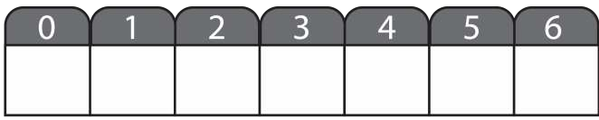
Hoare’s Quicksort Example:
•
L < P </= R
Now at the end we swap our pivot with the first element greater than it, if there is one. In this case there is and its 13 so we swap to complete the first pass through.
(put the = sign on same side as your pivot)
Left
#’s < P (7)
Right
#’s >/= P (7)
3
4
6
13
8
9
7
P (Pivot) = 7
If the Number (#) is Greater Than/ Equal to (>/=) the Pivot, it Stays Put
Else, if its Less Than (<) the Pivot, Swap it with 1st Element >/= than P

Slide 29
Hoare’s Quicksort Example:
•
L < P </= R
Now at the end we swap our pivot with the first element greater than it, if there is one. In this case there is and its 13 so we swap to complete the first pass through.
(put the = sign on same side as your pivot)
Left
#’s < P (7)
Right
#’s >/= P (7)
7
3
4
6
13
8
9
P (Pivot) = 7
If the Number (#) is Greater Than/ Equal to (>/=) the Pivot, it Stays Put
Else, if its Less Than (<) the Pivot, Swap it with 1st Element >/= than P

Slide 30
Hoare’s Quicksort Example:
•
L < P </= R
Now at the end we swap our pivot with the first element greater than it, if there is one. In this case there is and its 13 so we swap to complete the first pass through.
(put the = sign on same side as your pivot)
Left
#’s < P (7)
Right
#’s >/= P (7)
7
3
4
6
8
9
13
P (Pivot) = 7
If the Number (#) is Greater Than/ Equal to (>/=) the Pivot, it Stays Put
Else, if its Less Than (<) the Pivot, Swap it with 1st Element >/= than P

Slide 31
Hoare’s Quicksort Example:
•
L < P </= R
Now at the end we swap our pivot with the first element greater than it, if there is one. In this case there is and its 13 so we swap to complete the first pass through.
(put the = sign on same side as your pivot)
Left
#’s < P (7)
Right
#’s >/= P (7)
3
4
6
7
8
9
13
P (Pivot) = 7
If the Number (#) is Greater Than/ Equal to (>/=) the Pivot, it Stays Put
Else, if its Less Than (<) the Pivot, Swap it with 1st Element >/= than P

Slide 32
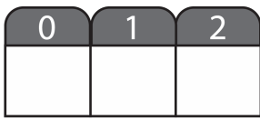
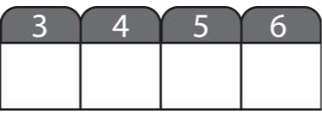
Hoare’s Quicksort Example:
•
L < P </= R
We now have two partitions with one with all the elements less than our first pivot and another with all those greater.
(put the = sign on same side as your pivot)
Left
#’s < P (7)
Right
#’s >/= P (7)
3
4
6
7
8
9
13
If the Number (#) is Greater Than/ Equal to (>/=) the Pivot, it Stays Put
Else, if its Less Than (<) the Pivot, Swap it with 1st Element >/= than P

Slide 33
Hoare’s Quicksort Example:
•
L < P </= R
Now the same operation will happen to each new segement. This happens until you get down to one element.
(put the = sign on same side as your pivot)
Left
#’s < P (7)
Right
#’s >/= P (7)
3
4
6
7
8
9
13
If the Number (#) is Greater Than/ Equal to (>/=) the Pivot, it Stays Put
Else, if its Less Than (<) the Pivot, Swap it with 1st Element >/= than P

Slide 34
Hoare’s Quicksort Example:
•
L < P </= R
Our pivots get picked accordingly and our partition dividers are set.
(put the = sign on same side as your pivot)
Left
’s < P (6)
Right
#’s >/= P (6)
Left
#’s < P (13)
Right
#’s >/= P (13)
3
4
6
7
8
9
13
If the Number (#) is Greater Than/ Equal to (>/=) the Pivot, it Stays Put
Else, if its Less Than (<) the Pivot, Swap it with 1st Element >/= than P

Slide 35
Hoare’s Quicksort Example:
However you’ll notice that both our remaining segements just happened to already be sorted. So though the code will work all the way through and down until there is only one element left, no numbers will change order from here on so this ends this example.
•
L < P </= R
(put the = sign on same side as your pivot)
Left
’s < P (6)
Right
#’s >/= P (6)
Left
#’s < P (13)
Right
#’s >/= P (13)
3
4
6
7
8
9
13
If the Number (#) is Greater Than/ Equal to (>/=) the Pivot, it Stays Put
Else, if its Less Than (<) the Pivot, Swap it with 1st Element >/= than P

Slide 36
Complexity of Partition
PartitionTime(n) is given by the number of iterations in the for loop.
Θ(n) : n = r – p + 1.
PARTITION(A, p, r)
x = A[r]
2. i = p-1
3. for j = p to r – 1
4. if A[j] ≤ x
5. i = i + 1
6. exchange A[i] with A[j]
7. exchange A[i + 1] with A[r]
8. return i + 1

Slide 37
Algorithm Performance
Running time of quicksort depends on whether the partitioning is balanced or not.
Best case: occurs when the recursion tree is always balanced
Worst case: occurs when the recursion tree is always unbalanced
Average case: computed by using expected value of running time assuming that the pivot elements are randomly distributed

Slide 38
Best-case Partitioning
Size of each subproblem ≤ n/2.
One of the subproblems is of size ⎣n/2⎦
The other is of size ⎡n/2⎤ −1.
Called a ⎣n/2⎦: (⎡n/2⎤ −1) split
Recurrence for running time
T(n) ≤ 2T(n/2) + PartitionTime(n)
= 2T(n/2) + Θ(n)
T(n) = Θ(n lg n)

Slide 39
Recursion Tree for Best-case Partition
cn
cn
cn/2
cn/2
cn
lg n
cn/4
cn/4
cn/4
cn/4
cn
c
c
c
c
c
c
cn
Total : O(n lg n)

Slide 40
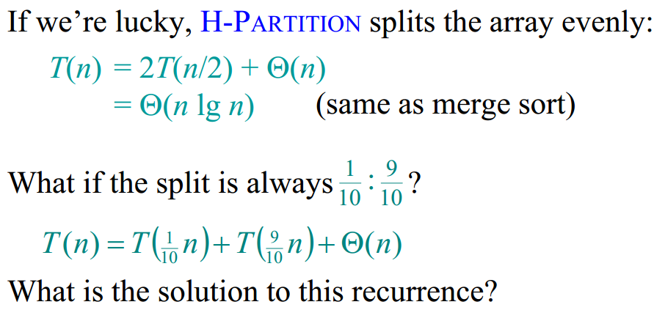
Best-case analysis

Slide 41
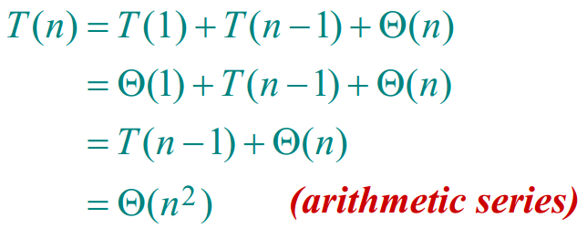
Worst-case of quicksort
Worst-Case Partitioning (Unbalanced Partitions):
Occurs when every call to partition results in the most unbalanced partition.
Partition is most unbalanced when
Subproblem 1 is of size n – 1, and subproblem 2 is of size 0 or vice versa.
pivot ≥ every element in A[p..r – 1] or pivot < every element in A[p..r – 1].
Every call to partition is most unbalanced when
Array A[1..n] is sorted or reverse sorted!
One side of partition always has one element.

Slide 42
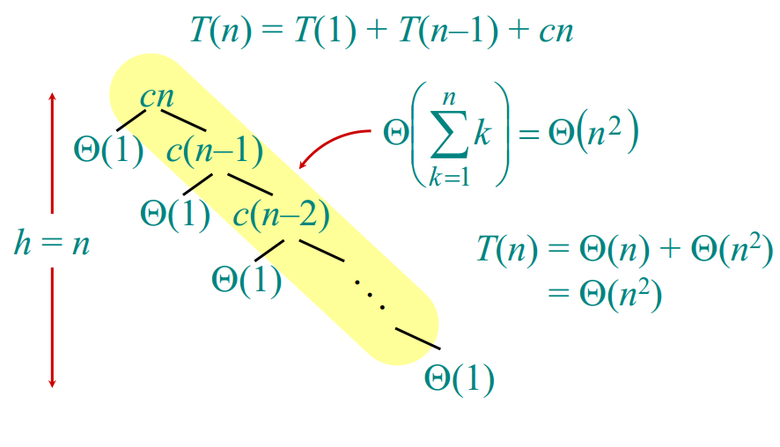
Worst-case recursion tree

Slide 43
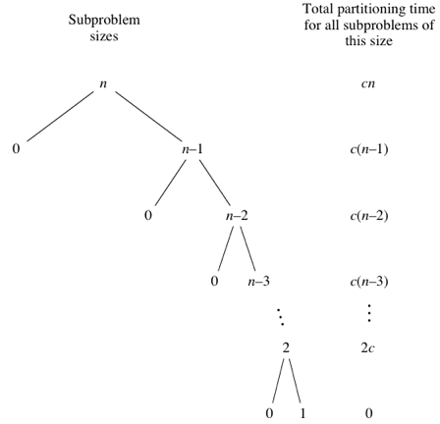
Elements to sort /
cn+c(n−1)+c(n−2)+⋯+2c​=c(n+(n−1)+(n−2)+⋯+2)
=c((n+1)(n/2)−1) .​
So, in the worst case, it runs in O(n²) time.

Slide 44
Expected Running time of QuickSort
We can show that the expected running time of QuickSort is O(nlg n), same as that of MergeSort.
So, even though, the worst case running time of QuickSort is worse than that of MergeSort, its Average running time is comparable to that of MergeSort.
For the sake of simplicity, we omit the mathematical details of the calculation of expected running time of QuickSort.

Slide 45
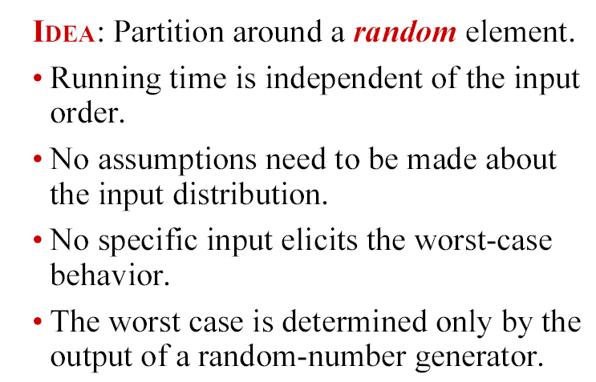
Randomized quicksort
How can we ENSURE that each element of A are equally likely to be the pivot?

Slide 46
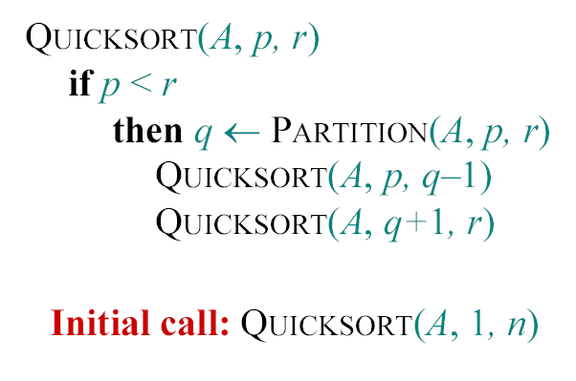
Randomized quicksort
Standard Problematic Algorithm :

Slide 47
Randomized quicksort
RANDOMIZED-PARTITION (A, p, r)
i←RANDOM(p, r)
exchange A[r]↔A[i]
return PARTITION(A, p, r)
RANDOMIZED-QUICKSORT (A,p,r)
if p<r
then q←RANDOMIZED-PARTITION (A, p, r)
RANDOMIZED-QUICKSORT (A, p, q-1)
RANDOMIZED-QUICKSORT (A, q+1, r)
Average and worst case running time of Randomized-QuickSort is the same as that of QuickSort; but in practice Randomized-QuickSort is typically much faster

Slide 48
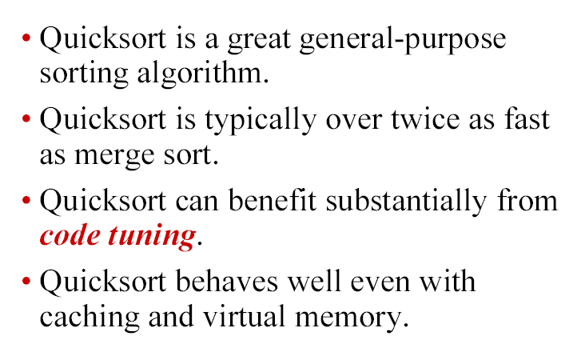
Quicksort in practice

